Slide 1


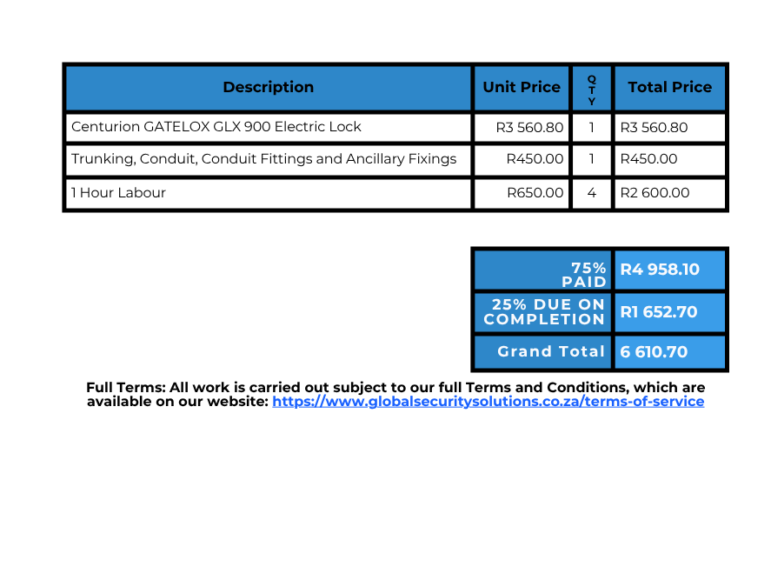
PROFORMA INVOICE
Date: 22 May 2026
PRO-INV NR: 22526-1
Global Security Solutions
Bill To:
Big Bay Solutions
From:
Global Security Solutions
062 955 8559
66 Robyn RD, Durbanville
REFERENCE: 75 South RD-GATELOCK
Payment Information:
DATE:
Bank:
Account Holder:
Account Type:
Account Number:
Branch Code:
FNB/RMB
Global Security Solutions
First Business Zero Account
63182000223
250655
NAME:
SIGN:
www.GlobalSecuritySolutions.co.za
PAGE 1 OF 1

Slide 2
DONT MOVE
PAGE.

Slide 3

GENERAL TERMS
&
CONDITIONS OF QUOTATION
Global Security Solutions
These Terms and Conditions ("Agreement") govern the provision and installation of security systems and related services ("Services") by Global Security Solutions ("we," "us," "our") to the customer ("you," "your"). This Agreement, together with the official Quotation provided, constitutes the entire contract between both parties.
1. Scope of Services
We agree to supply and install the security equipment ("System") as specified in the signed Quotation at the address provided ("Site"). The scope includes the physical installation of components, system configuration, basic user training upon handover, and any other services explicitly detailed in the Quotation. Services may include, but are not limited to:
Intruder Detection and Alarm Systems
CCTV Surveillance Systems
Access Control and Intercom Systems
Electric Fencing and Perimeter Security
Gate and Garage Automation
Smart Home and System Integration
2. System Specifications
The make, model, quantity, and specific capabilities of all System components will be detailed in the formal Quotation. We reserve the right to propose a substitution of components with items of equal or superior quality and specification if the quoted items become unavailable. Such a substitution will only be made subject to your prior written approval.
3. Installation Procedures
3.1. Site Access: You shall provide us with safe, unimpeded access to the Site during agreed-upon working hours to perform the installation.
3.2. Customer Obligations: You are responsible for ensuring the Site is ready for installation, including providing a stable 230V AC power supply at designated points. You must inform us of any concealed utilities (e.g., water pipes, electrical wiring) or structural peculiarities. We are not liable for damages to unmarked or undisclosed utilities.
3.3. Timeline: The installation timeline provided is an estimate. We will make every reasonable effort to meet these dates but are not liable for delays caused by factors beyond our control (e.g., adverse weather, supplier delays, or changes requested by you).
3.4. Completion & Handover: Installation is deemed complete upon successful system testing and demonstration. Your acceptance of the system is confirmed by signing our job completion form or by using the system after handover
4. Warranties
4.1. Workmanship: We provide a 12-month warranty on our installation workmanship from the date of completion. This covers faults directly resulting from our installation process.
4.2. Equipment: All new equipment is covered by the manufacturer’s warranty, the terms and duration of which vary by product. We will facilitate warranty claims on your behalf, but the manufacturer holds the final decision on repair or replacement.
4.3. Exclusions: This warranty does not cover faults arising from:
Misuse, neglect, or tampering by any person other than our authorized technicians.
Acts of God, power surges, lightning, fire, flood, or other external forces.
Failure of third-party services required for system operation (e.g., internet connection, armed response).
Consumable items (e.g., batteries, fuses).

Slide 4
GENERAL TERMS
&
CONDITIONS OF QUOTATION
Global Security Solutions
5. Payment Terms
5.1. Deposit: A deposit of 75% of the total quoted price is required upon acceptance of the Quotation to secure equipment and scheduling.
5.2. Final Payment: The outstanding balance of 25% is due upon completion of the installation and successful handover.
5.3. Ownership: All equipment remains the property of Global Security Solutions until the full, outstanding balance is paid. We reserve the right to enter the Site and remove the System in the event of non-payment.
5.4. Late Payments: We reserve the right to charge interest on all overdue accounts at the maximum rate permissible by law, alternatively at prime plus 5% (as charged by our bankers), calculated daily and compounded monthly from the due date until the date of full payment.
6. Data Privacy
6.1. Compliance: We handle your personal information in compliance with the Protection of Personal Information Act (POPIA) of South Africa. Your data is used solely for the purposes of providing our Services, billing, and communication.
6.2. System Data: You are the legal "Data Controller" for all data captured and stored by your System (e.g., CCTV footage, access logs). You are solely responsible for its lawful use and management.
6.3. Remote Access: For maintenance or troubleshooting, we may require remote access to your System. This will only be done with your explicit consent for each instance, which may be provided verbally, via email, or through an official support request.
7. Maintenance and Support
7.1. Post-Warranty Service: Service calls or repairs requested after the warranty period will be chargeable at our standard rates.
7.2. Maintenance Contracts: We offer optional Maintenance Contracts for ongoing preventative care and priority support. The terms of these contracts are outlined in a separate agreement.
7.3. Call-Outs: A standard call-out fee is applicable for all on-site support requests outside of a valid workmanship warranty claim.
8. Limitation of Liability
8.1. No Guarantee: You acknowledge that a security system is a deterrent and does not offer a guarantee against burglary, loss, or harm. Global Security Solutions is not an insurer.
8.2. Indemnity: We shall not be liable for any direct, indirect, or consequential loss or damage suffered by you or any third party, including loss of property, injury, or loss of life, arising from system failure, non-performance, or any breach of this Agreement, except in the case of our gross negligence.
8.3. Maximum Liability: In any event, our total liability under this Agreement shall be limited to the total value paid by you for the Services outlined in the relevant Quotation.
9. Termination
9.1. By You: You may terminate this Agreement by providing written notice. Upon termination: The 75% initial deposit is non-refundable and will be retained by us to cover administrative costs and equipment stocking. If termination occurs after work has commenced, you will be liable for the cost of all work performed and non-returnable equipment ordered up to the date of termination. Any such costs incurred in excess of the retained deposit will be invoiced and become immediately due.

Slide 5
GENERAL TERMS
&
CONDITIONS OF QUOTATION
Global Security Solutions
9.2. By Us: We may terminate this Agreement with immediate effect if you fail to make payment as per the terms or breach any other material clause of this Agreement.
10. General
10.1. Governing Law: This Agreement shall be governed by and interpreted in accordance with the laws of the Republic of South Africa.
10.2. Dispute Resolution: Should any dispute arise, both parties agree to first attempt to resolve it amicably through negotiation. If unresolved, the matter will be subject to the jurisdiction of the Cape Town courts.
10.3. Entire Agreement: This document and the associated Quotation represent the entire agreement between the parties and supersede all prior communications. Any amendments must be made in writing and signed by both parties.
By accepting our Quotation, you acknowledge that you have read, understood, and agree to be bound by these Terms and Conditions.
Global Security Solutions
Website: https://globalsecuritysolutions.co.za
Email: Kyle@GlobalSecuritySolutions.co.za
Contact: 062 955 8559
DATE:
NAME:
SIGN:

Slide 6

General Terms & Conditions of Quotation
Global Security Solutions
Global Security Solutions - Subcontracting Terms and Conditions for Labor-Only Services
Preamble: These terms govern the agreement between the hiring party ("the Contractor") and Global Security Solutions ("the Subcontractor") for the provision of installation, maintenance, or repair labor.
Part A: General Terms & Conditions
A1. Relationship of Parties
Global Security Solutions (GSS) is engaged as an independent Subcontractor. This agreement does not create an employer/employee relationship. The Contractor is responsible for all end-client communication and management.
A2. Workmanship Guarantee
The Subcontractor provides a twelve (12) month warranty to the Contractor on the quality of its workmanship, covering the direct labour aspect of the installation only.
A3. Site Readiness and Access
The Contractor shall ensure the work site is safe, clear, and ready for work to commence as scheduled, and will arrange for timely access for the Subcontractor's personnel.
A4. Electrical Power Supply
The Contractor is responsible for ensuring a dedicated 220V AC electrical power supply is available at all points required for the system's operation before work commences.
A5. Limitation of Liability
The Subcontractor shall not be held liable for:
Any pre-existing conditions on the site, including faulty wiring or structural issues.
Damages resulting from the actions or negligence of the Contractor, the end-client, or any other third party.
Any failure, damage, or incompatibility of materials, components, or equipment supplied by the Contractor or the end-client.
Any indirect or consequential damages, including, but not limited to, loss of profit, business interruption, loss of data, or costs arising from system failure.
The Subcontractor's total liability for any direct damages shall not exceed the amount paid by the Contractor for the specific work that is the subject of the claim.
A6. Delays and Standby Time
The Subcontractor's pricing is based on the continuous, unimpeded execution of the work. If the Subcontractor's personnel are unable to work for reasons within the Contractor's control (including but not limited to lack of site access, incorrect materials, or delays by other trades), the time lost will be billed to the Contractor as standby time at the Subcontractor's standard hourly labor rate.
A7. Variations to Scope of Work
Any changes or additions to the agreed scope of work must be documented in a written "Variation Order" and signed by both the Contractor and Subcontractor before the additional work is performed. All varied work will be billed at the Subcontractor's standard rates unless otherwise agreed in writing.
A8. Dispute Resolution
Should any dispute arise between the parties, they agree to first attempt to resolve it through direct negotiation. If the dispute is not resolved within fourteen (14) days, both parties agree to refer the matter to a mutually agreed-upon mediator before pursuing any other legal remedies. The costs of mediation shall be shared equally.
A9. Errors and Omissions Excepted (E&OE)
The Subcontractor reserves the right to correct any typographical errors or omissions in any documentation.
Sign:
Page 1 of 2

Slide 7
General Terms & Conditions of Quotation
Global Security Solutions
Part B: Terms for Labor-Only Projects
B1. Contractor's Responsibility for Materials
The Contractor is responsible for supplying all equipment, materials, fixtures, and fittings. The Contractor must ensure all materials are on-site, correct, compatible, and in good working order to prevent delays. The Subcontractor is not liable for delays or faults arising from incorrect or faulty materials.
B2. Billing and Payment
Labor hours will be reconciled weekly and invoiced to the Contractor every Friday for the preceding week. Payment is due in full by the following Monday. The Subcontractor reserves the right to suspend all work if the Contractor's account is not current.
B3. Equipment Warranty and Liability
The Subcontractor provides no warranty on any equipment supplied by the Contractor or end-client. The Contractor is solely responsible for managing all equipment performance issues and warranty claims directly with the manufacturer or supplier.
B4. Termination
The Subcontractor may suspend work or terminate this agreement with immediate effect if the Contractor fails to make any payment by the due date or otherwise commits a material breach of these terms. Upon termination, the Contractor is liable for payment for all work completed up to the date of termination, including any materials ordered or costs incurred.
Payment Information:
Bank:
To:
Savings ACC NR:
Email:
Capitec Bank
MR K CASS
1495208522
Kyle@GSSolutions.co.za
Sign:
Page 2 of 2

Slide 8
DONT MOVE
PAGE.

